Slide 1
COSC 606: Homework 2 Results
By - Adarsh Ghimire (100058927)
06 MARCH 2021

Slide 2
Task 2
Batch Gradient Descent on MNIST Dataset

Slide 3
Batch Gradient Descent on MNIST Dataset Details and Results
Network Details | Network 1 | Network 2 | Network 3
Hidden Layers / Neurons | 1 / 64 | 2 / 64, 32 | 3 / 64, 32, 32
Network Initialization | Xavier | Xavier | Xavier
Learning rate | 1.0 | 1.0 | 1.0
Epochs | 4000 | 4000 | 4000
Training data size | 54,000 | 54,000 | 54,000
Validation data size | 6,000 | 6,000 | 6,000
Test data size | 10,000 | 10,000 | 10,000
Hidden layers activation | Sigmoid | Sigmoid | Sigmoid
Output layer activation | Softmax | Softmax | Softmax
Loss | Categorical Cross entropy | Categorical Cross entropy | Categorical Cross entropy
Results | Network 1 | Network 2 | Network 3
Training Accuracy | 96.68 % | 97.24 % | 97.23 %
Validation Accuracy | 96.83 % | 97.10 % | 96.31 %
Test Accuracy | 96.08 % | 96.26 % | 95.94 %
Training Loss | 0.14855 | 0.13036 | 0.14048

Slide 4
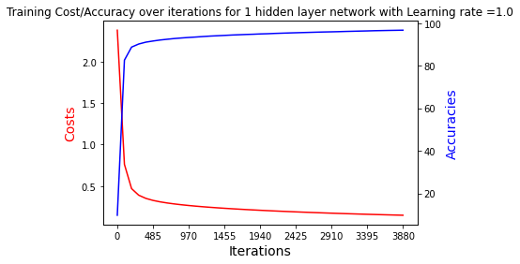
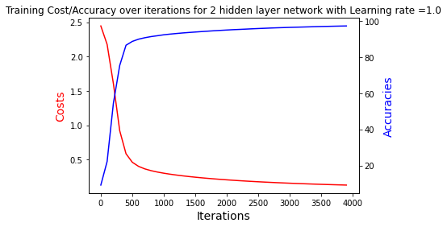
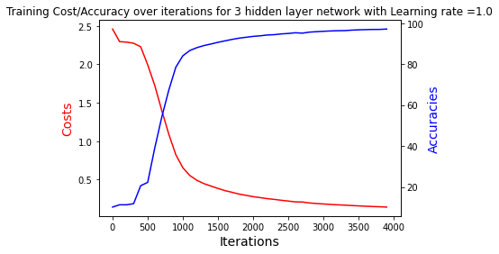
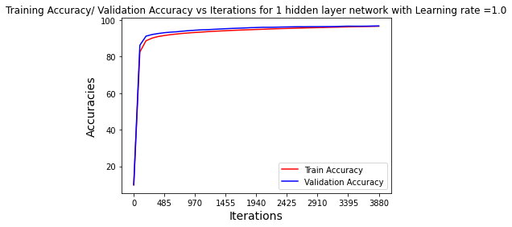
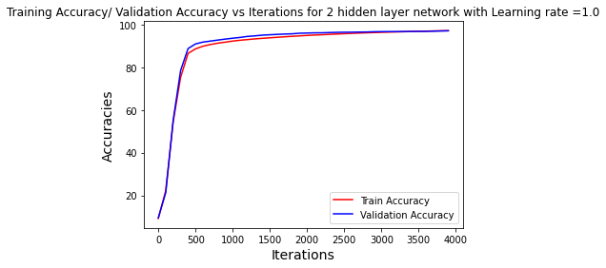
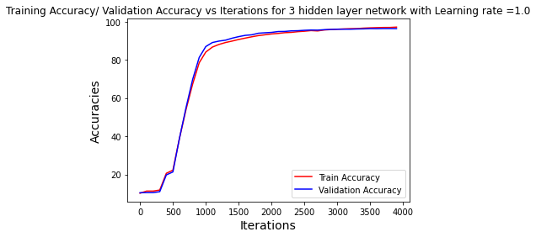
Network Convergence Graph
Network 1
Network 2
Network 3

Slide 5
Task 3
Mini-Batch Gradient Descent on MNIST Dataset (Sigmoid vs ReLU)

Slide 6
Task 3 – Mini-Batch Gradient Descent on MNIST Dataset
Network Parameters on both network
 | Network
Hidden Layers / Neurons | 3 / 64, 32, 32
Learning rate | 1.0
Epochs | 100
Batch Size | 128
Training data size | 54,000
Validation data size | 6,000
Test data size | 10,000
Output layer activation | Softmax
Loss | Categorical Cross entropy
Results
 | Sigmoid Network | ReLU Network
Network Initialization | Xavier | he
Training Accuracy | 99.60 % | 99.48 %
Validation Accuracy | 97.21 % | 97.15 %
Test Accuracy | 96.92 % | 96.37 %
Training Loss | 0.09434 | 0.18361

Slide 7
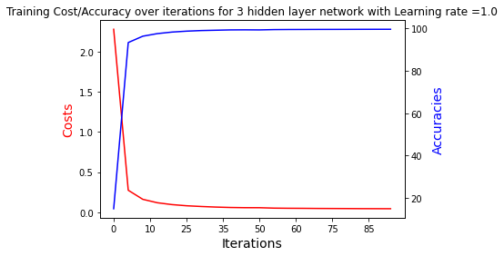
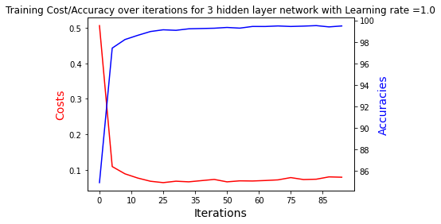
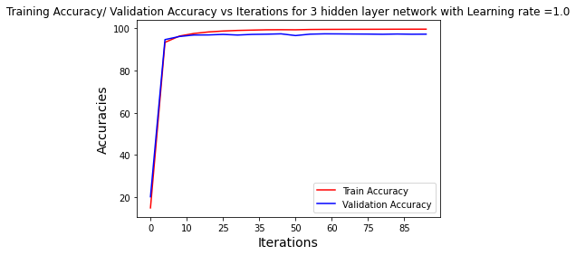
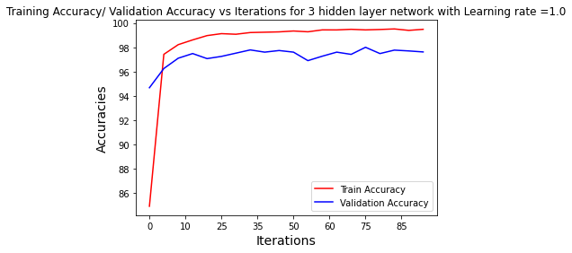
Network Convergence Graphs
Sigmoid Network
ReLU Network

Slide 8
Overall Comparison between 3 hidden layered network
 | Batch Network | Mini Batch Network 1 | Mini Batch Network 2
Hidden Layers / Neurons | 3 / 64, 32, 32 | 3 / 64, 32, 32 | 3 / 64, 32, 32
Network Initialization | Xavier | Xavier | he
Learning rate | 1.0 | 1.0 | 1.0
Hidden layer activation | Sigmoid | Sigmoid | ReLU
Training Accuracy | 97.23 % | 99.60 % | 99.48 %
Validation Accuracy | 96.31 % | 97.21 % | 97.15 %
Test Accuracy | 95.94 % | 96.92 % | 96.37 %
Training Loss | 0.14048 | 0.09434 | 0.18361
Total Epochs | 4000 | 100 | 100

Slide 9
Network Convergence Graphs
Batch Sigmoid Network
Mini-batch Sigmoid Network
Mini-batch ReLU Network

Slide 10
Conclusion
Batch Gradient Descent reaches towards convergence after 3000 epochs only
Mini-batch Gradient Decent reaches convergence after 20 epochs only
In my case, Training accuracy of the batch gradient descent network is less compared to mini-batch ones, which is due to the fact that the network was trained only for 4000 epochs in case of batch gradient descent which is not sufficient enough as can be seen from the diagram, that the network loss or accuracy has not plateaued completely.
Validation accuracy of batch gradient descent based network is higher than training accuracy, as it can be generalized from the fact that, in batch network the whole training data is considered into account for weight updates, thus the network is more generalized during weight updates.
Mini-batch network training accuracy is higher than validation accuracy since the weight updates has to be done for batches only which does not generalizes more. However, the convergence in minibatch is faster, because the weight updates that happens with the help of batch resulting in faster updates of weights, and convergence of the network. That means during one epoch there will be several updates on weights with the help of batches of data.
Sigmoid vs ReLU based network, the convergence on ReLU is faster, and also the training time of the ReLU based network is less because of little less network complexity. Otherwise, there is not huge differences between them when the current data, and network is considered. The significant performance difference would have been seen if the Convolutional neural network was used during feature extraction with the relu activation compared to sigmoid activation.

